Slide 1

Notes:
Hi, I’m Gopi Trinadh – GSoC contributor with Scala, working on LLM4s. In the next ten minutes I’ll show you what Retrieval-Augmented Generation actually buys you, what I shipped in EmbedX, and the DBx roadmap that makes RAG practical instead of aspirational. I’ll be blunt about what works and what wastes your time.”

Slide 2
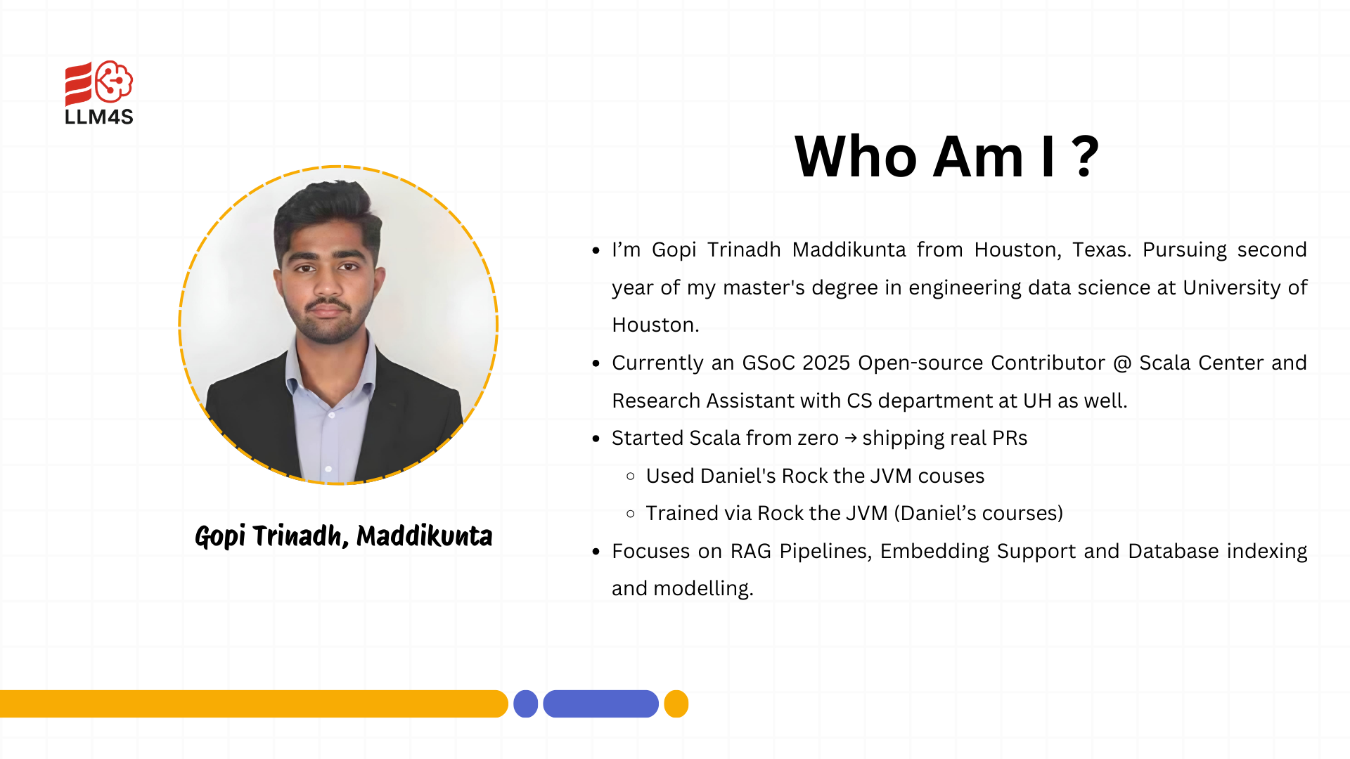

Slide 3
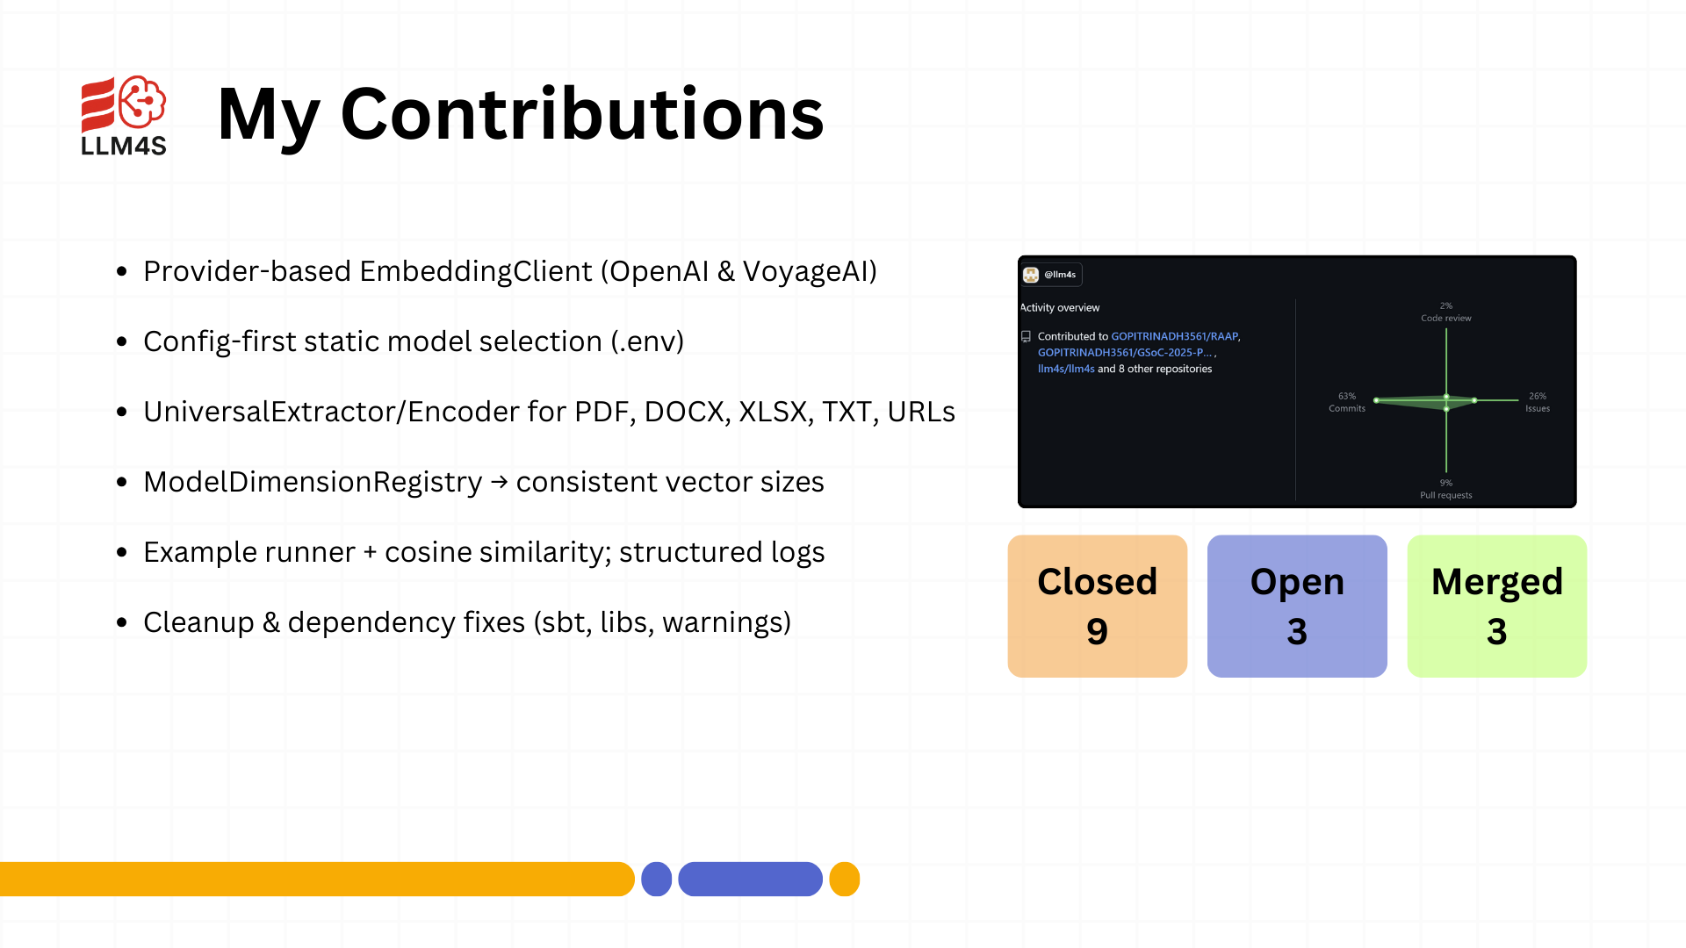

Slide 4
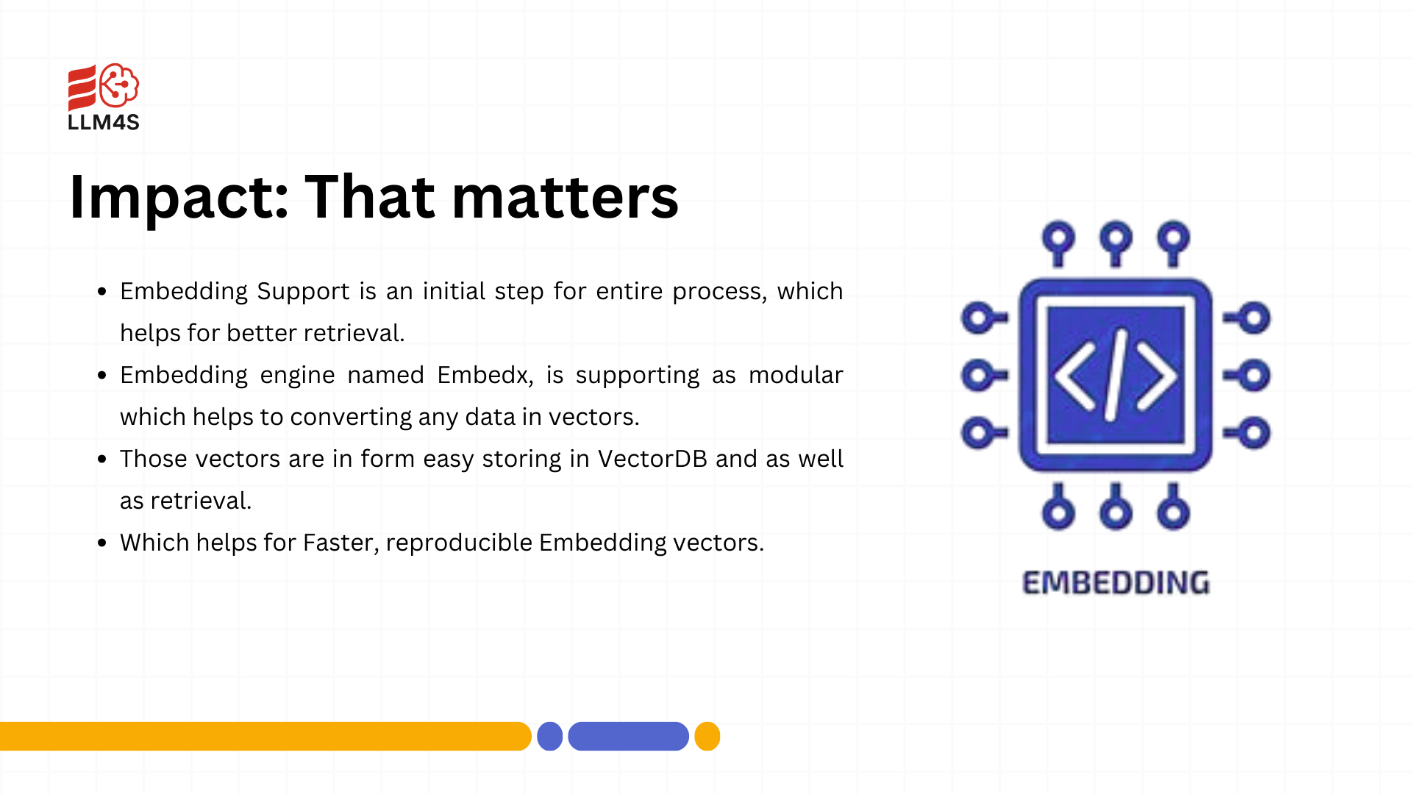

Slide 5
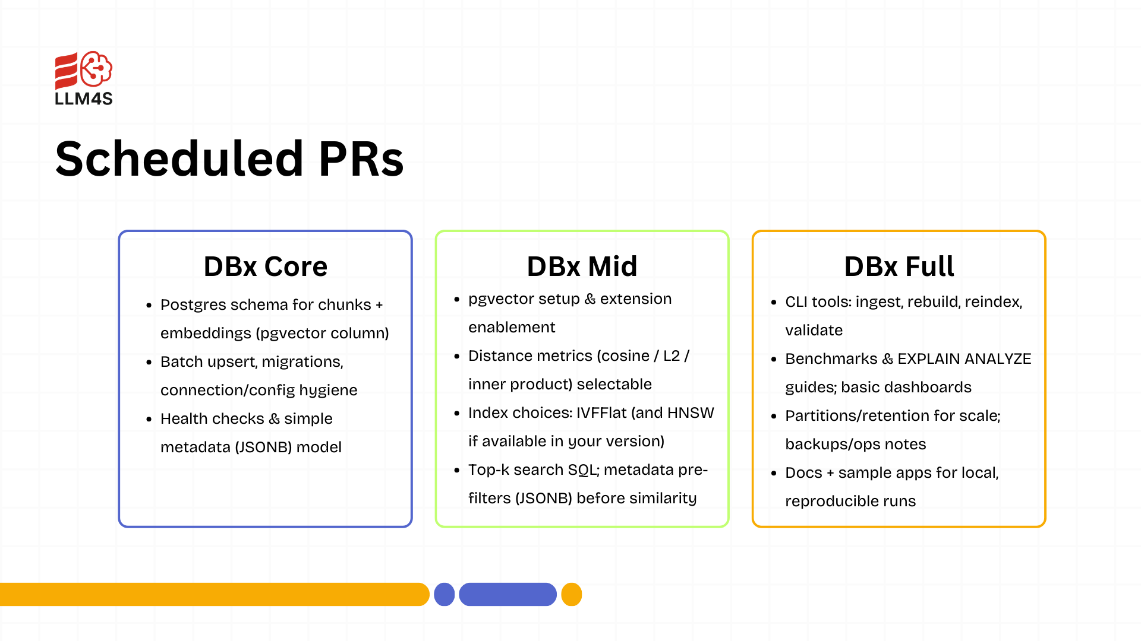

Slide 6
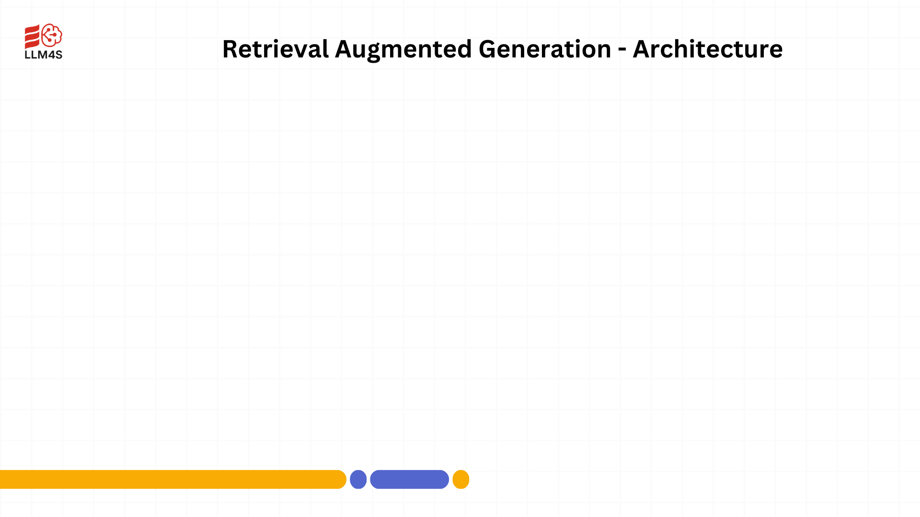

Slide 7
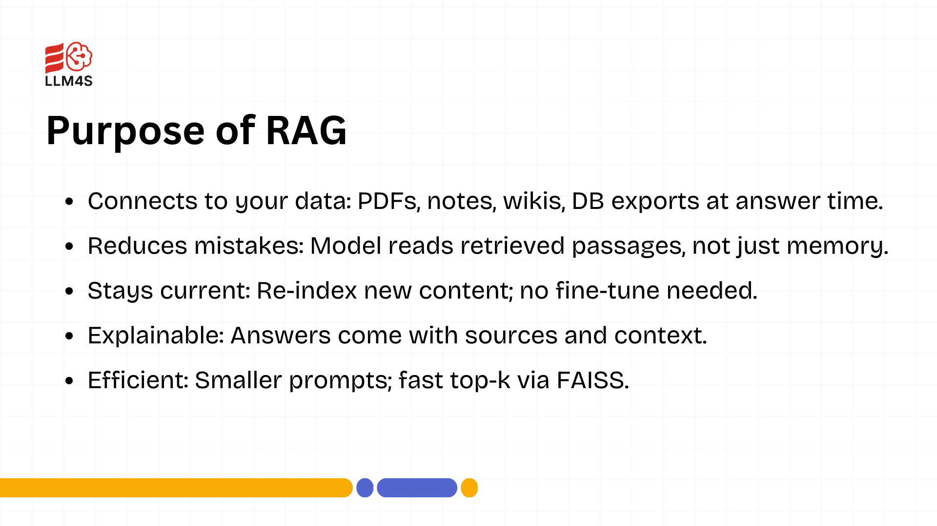

Slide 8
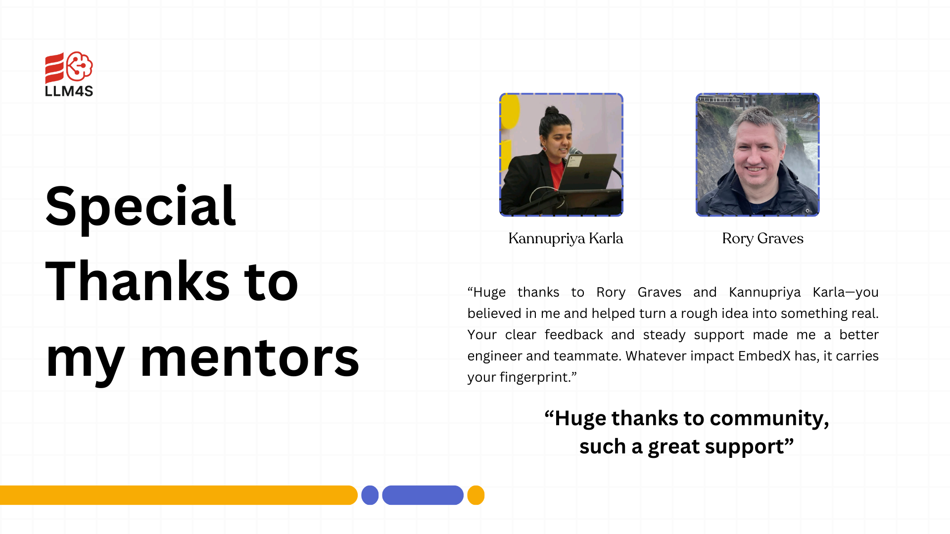

Slide 9


